Slide 1
Feature Learning and Importance Scoring on Incomplete Anomaly Datasets
Bachelor Thesis Final Presentation
Julian Hoffmeister
10/10/2022
Research Supervisor:
Andreas Lohrer
Responsible Professor:
Prof. Dr. Peer Kröger

Slide 2
Contents
Introduction
Related Work
Research Questions
Concept
Evaluation
Experiments & Results
Conclusion & Future Work

Slide 3
Introduction
1) Missing
Values (MVs)
Domain:
Missing Value Datasets &
Performing Tasks
(Clustering, Classification, Anomaly Detection, …)
ID | A | B
1 | 1 | 7
2 | 3
3 |  | 3
4 | 2
5 | 1 | 6
6 | 2 | 5
7 | 2 | 6
8 | 3 | 7
9 | 6 | 2
10 | 7
11 | 7 | 3
12 | 8 | 1
13 | 6 | 3
14 | 7 | 2
15 | 7 | 4
16 |  | 1
B
2) Computation of distances
?
A

Slide 4
Introduction
Problem:
How can we fill the missing values in order to optimize cluster performance?
ID | A | B
1 | 1 | 7
2 | 3
3 |  | 3
4 | 2
5 | 1 | 6
6 | 2 | 5
7 | 2 | 6
8 | 3 | 7
9 | 6 | 2
10 | 7
11 | 7 | 3
12 | 8 | 1
13 | 6 | 3
14 | 7 | 2
15 | 7 | 4
16 |  | 1
B
A

Slide 5
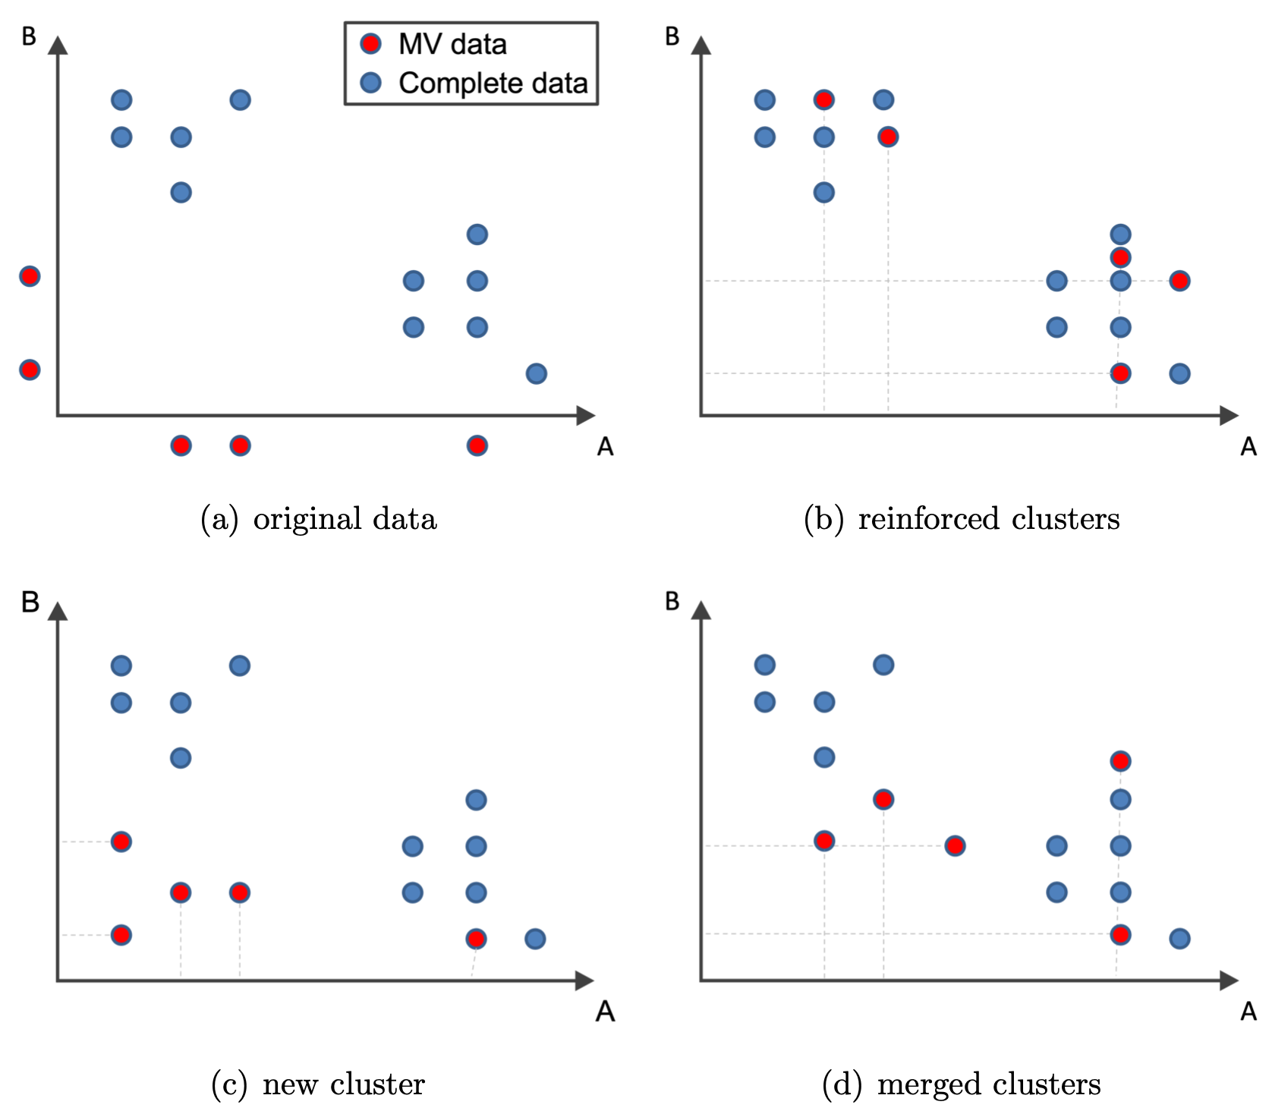
Introduction
Impact of MV imputation

Slide 6
Introduction
Motivation:
Learn filling values by optimizing cluster performance
Investigate influence of dataset dimensionality
Explainability of model-based imputation strategies
ID | A | B
1 | 1 | 7
2 | 3 | ?
3 | ? | 3
4 | 2 | ?
5 | 1 | 6
6 | 2 | 5
7 | 2 | 6
8 | 3 | 7
9 | 6 | 2
10 | 7 | ?
11 | 7 | 3
12 | 8 | 1
13 | 6 | 3
14 | 7 | 2
15 | 7 | 4
16 | ? | 1
B
Missing Values
?
Cluster Performance
A

Slide 7
Contents
Introduction
Related Work
Research Questions
Concept
Evaluation
Experiments & Results
Conclusion & Future Work

Slide 8
Related Work
Imputation Strategies
Deletion of data
Single Imputation
Multiple Imputation^{[1]}
ML-based Approaches^{[2] [3] [4]}
Imputation with KNN
Recurrent Neural Network (RNN)
Random Forest
Support Vector Machine (SVM)
Multi-Layer Perceptron
Attention-Based Transformer Networks
Importance based Feature Weighting
Clustering in lower Dimensionalities^{[5] [6] [7]}
Projected Clustering
Subspace Clustering
Dimensionality Reduction
Feature Importance
ML-based approaches with Feature Importance^{[8] [9]}
TabNet^{[4]}
Impact of Imputation on subseq. Clustering
Several studies from the field of biology^{[10] [11] [12] [13]}
No significant impact of imputation strategies on subsequent clustering (even with high imputation accuracy ratings)
Strong dependency of imputation and clustering performance and the dataset used

Slide 9
Related Work
Research Gaps
Optimisation of cluster performance with Model-based Imputation Approaches
Explainability of model-based imputation
Influence of Feature Distributions & Outliers
Influence of Dataset Dimensionality

Slide 10
Contents
Introduction
Related Work
Research Questions
Concept
Evaluation
Experiments & Results
Conclusion & Future Work

Slide 11

Research Questions
RQ 1
How is it possible to improve clustering of missing values/dimensions datasets with model based filling strategies?
1
2
n
 |  | . . .
RQ 2
How does the number of dimensions influence the cluster/outlier results?
RQ 3
How is it possible to make model based filling strategies explainable?

Slide 12
Contents
Introduction
Related Work
Research Questions
Concept
Evaluation
Experiments & Results
Conclusion & Future Work

Slide 13
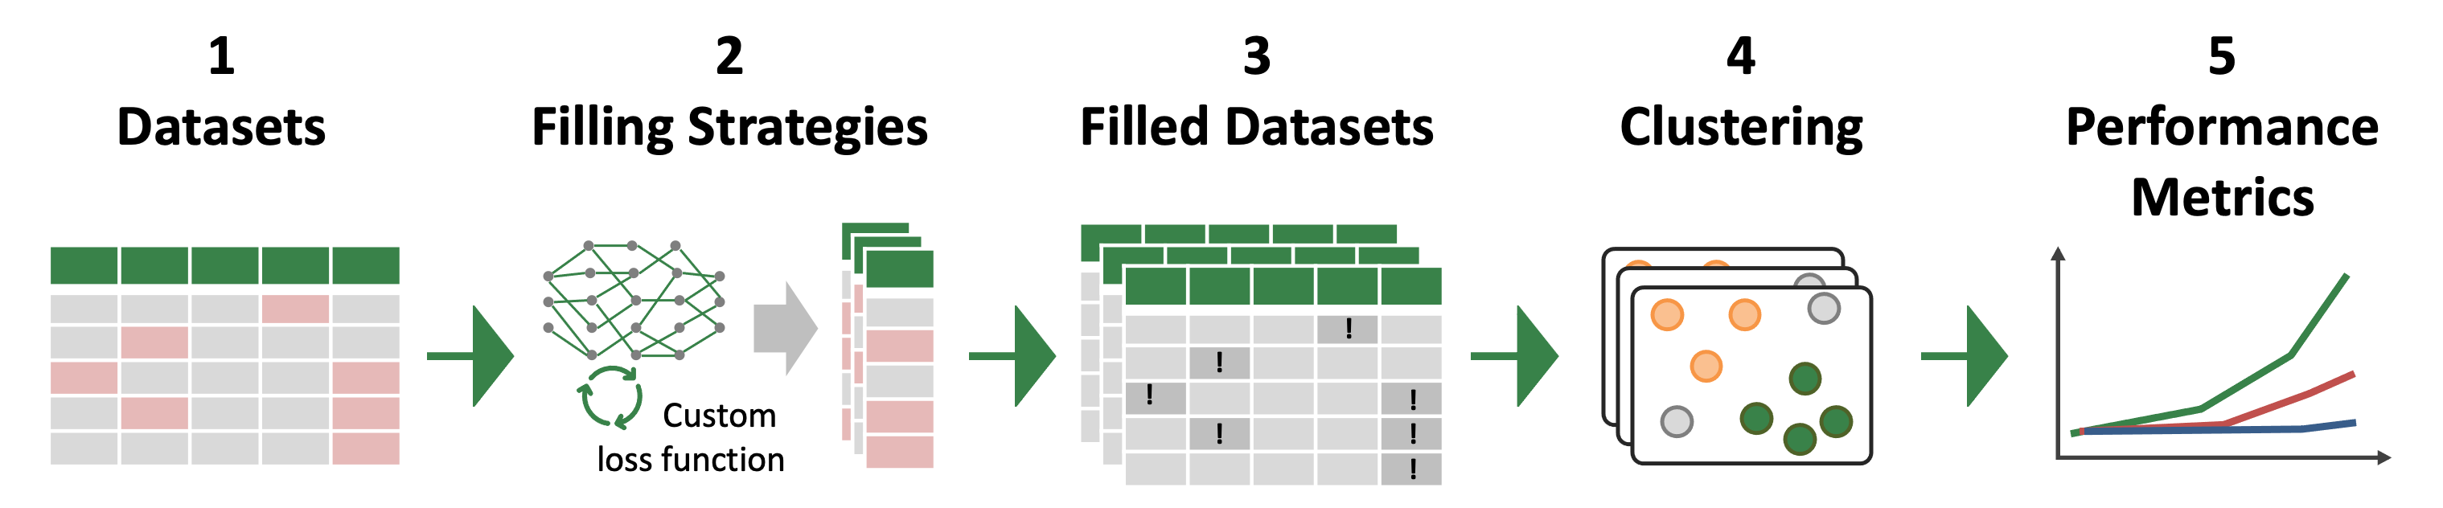
Concept

Slide 14
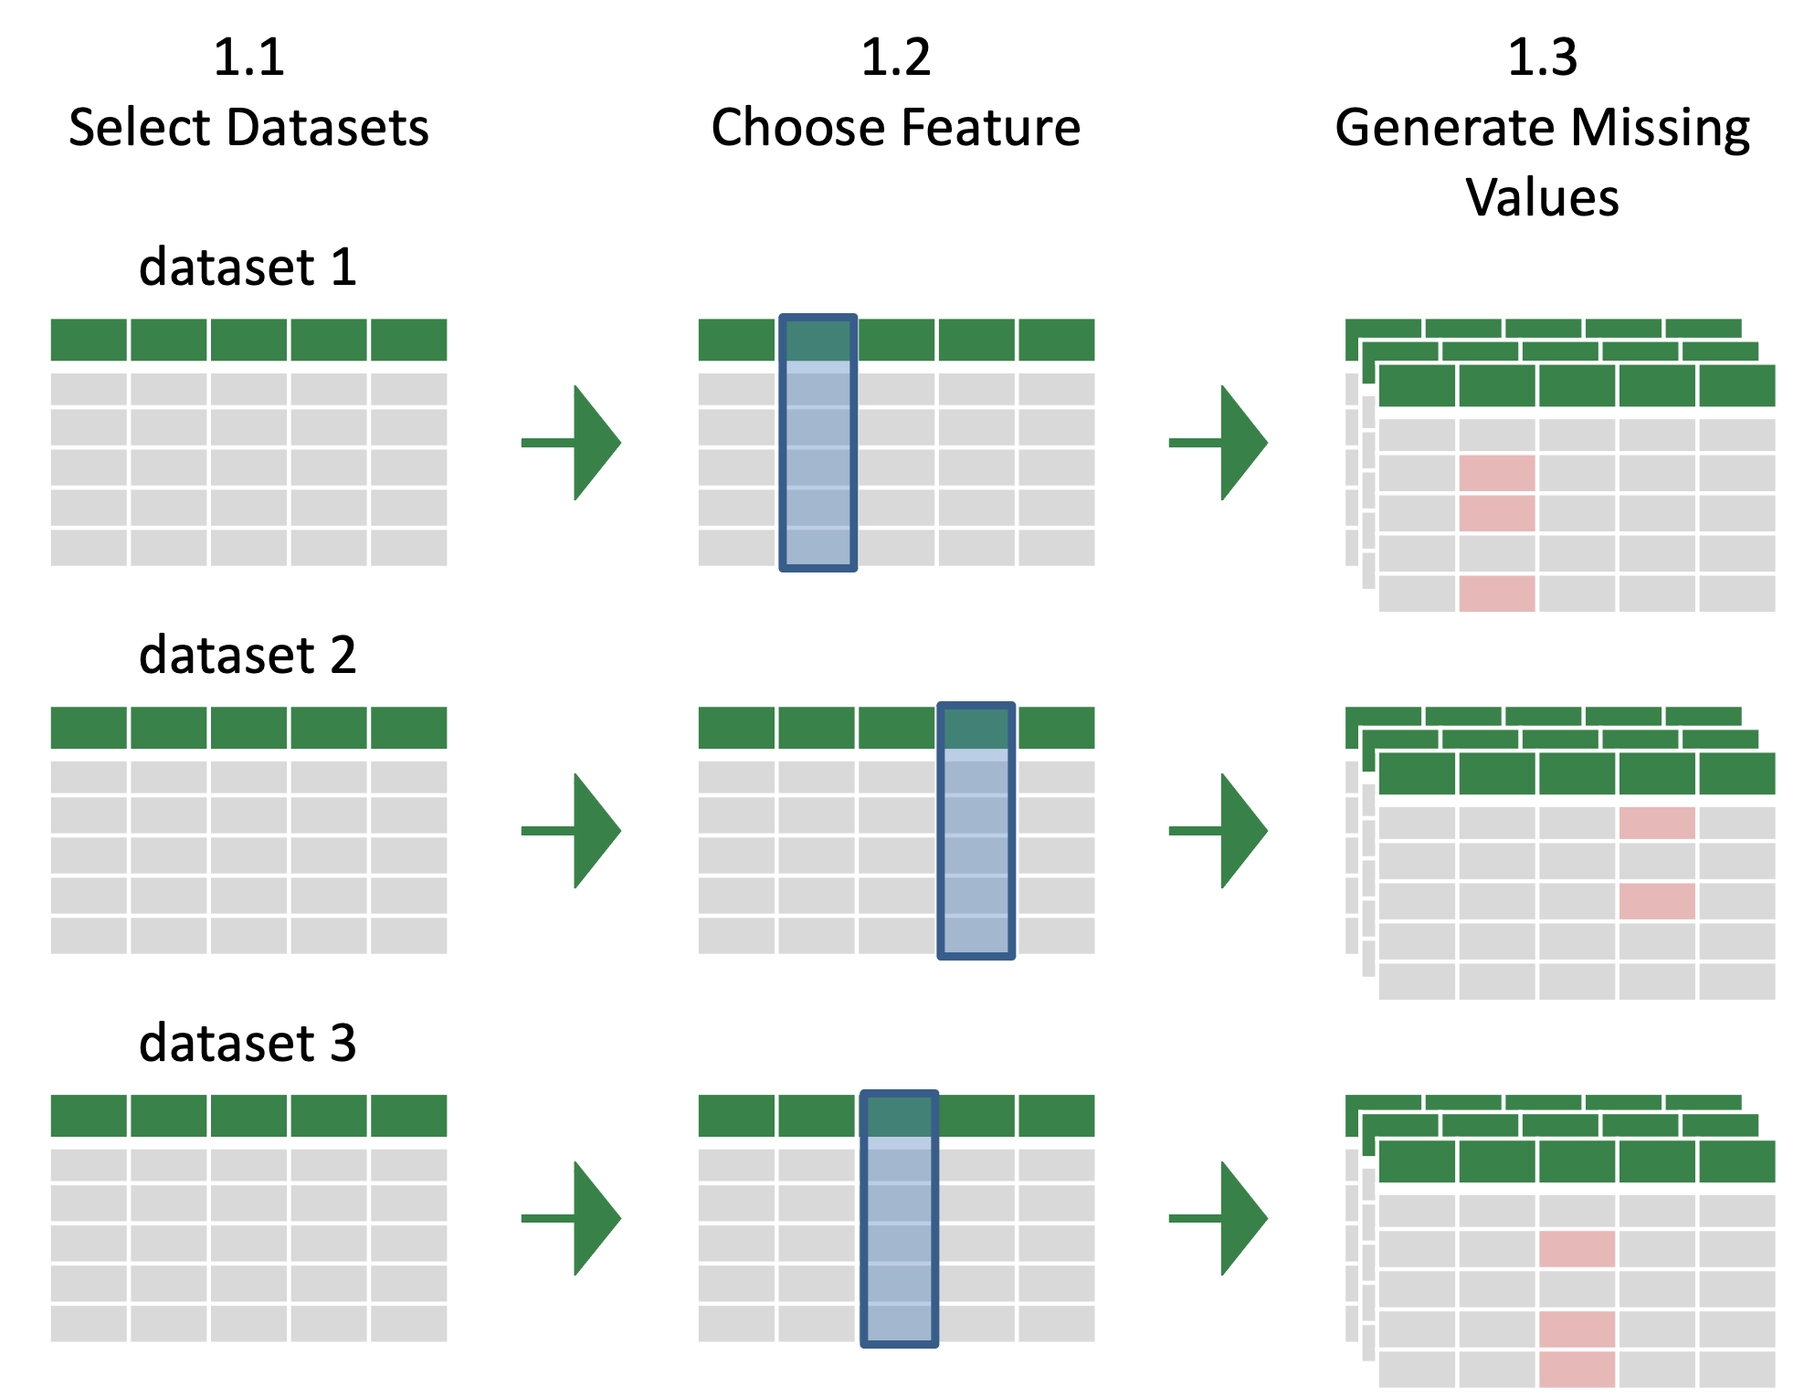
Concept – Datasets
Notes:
More MV features possible, but only one feature will be analyzed regarding impact on clustering in order to isolate experiments from the dependencies of other features

Slide 15
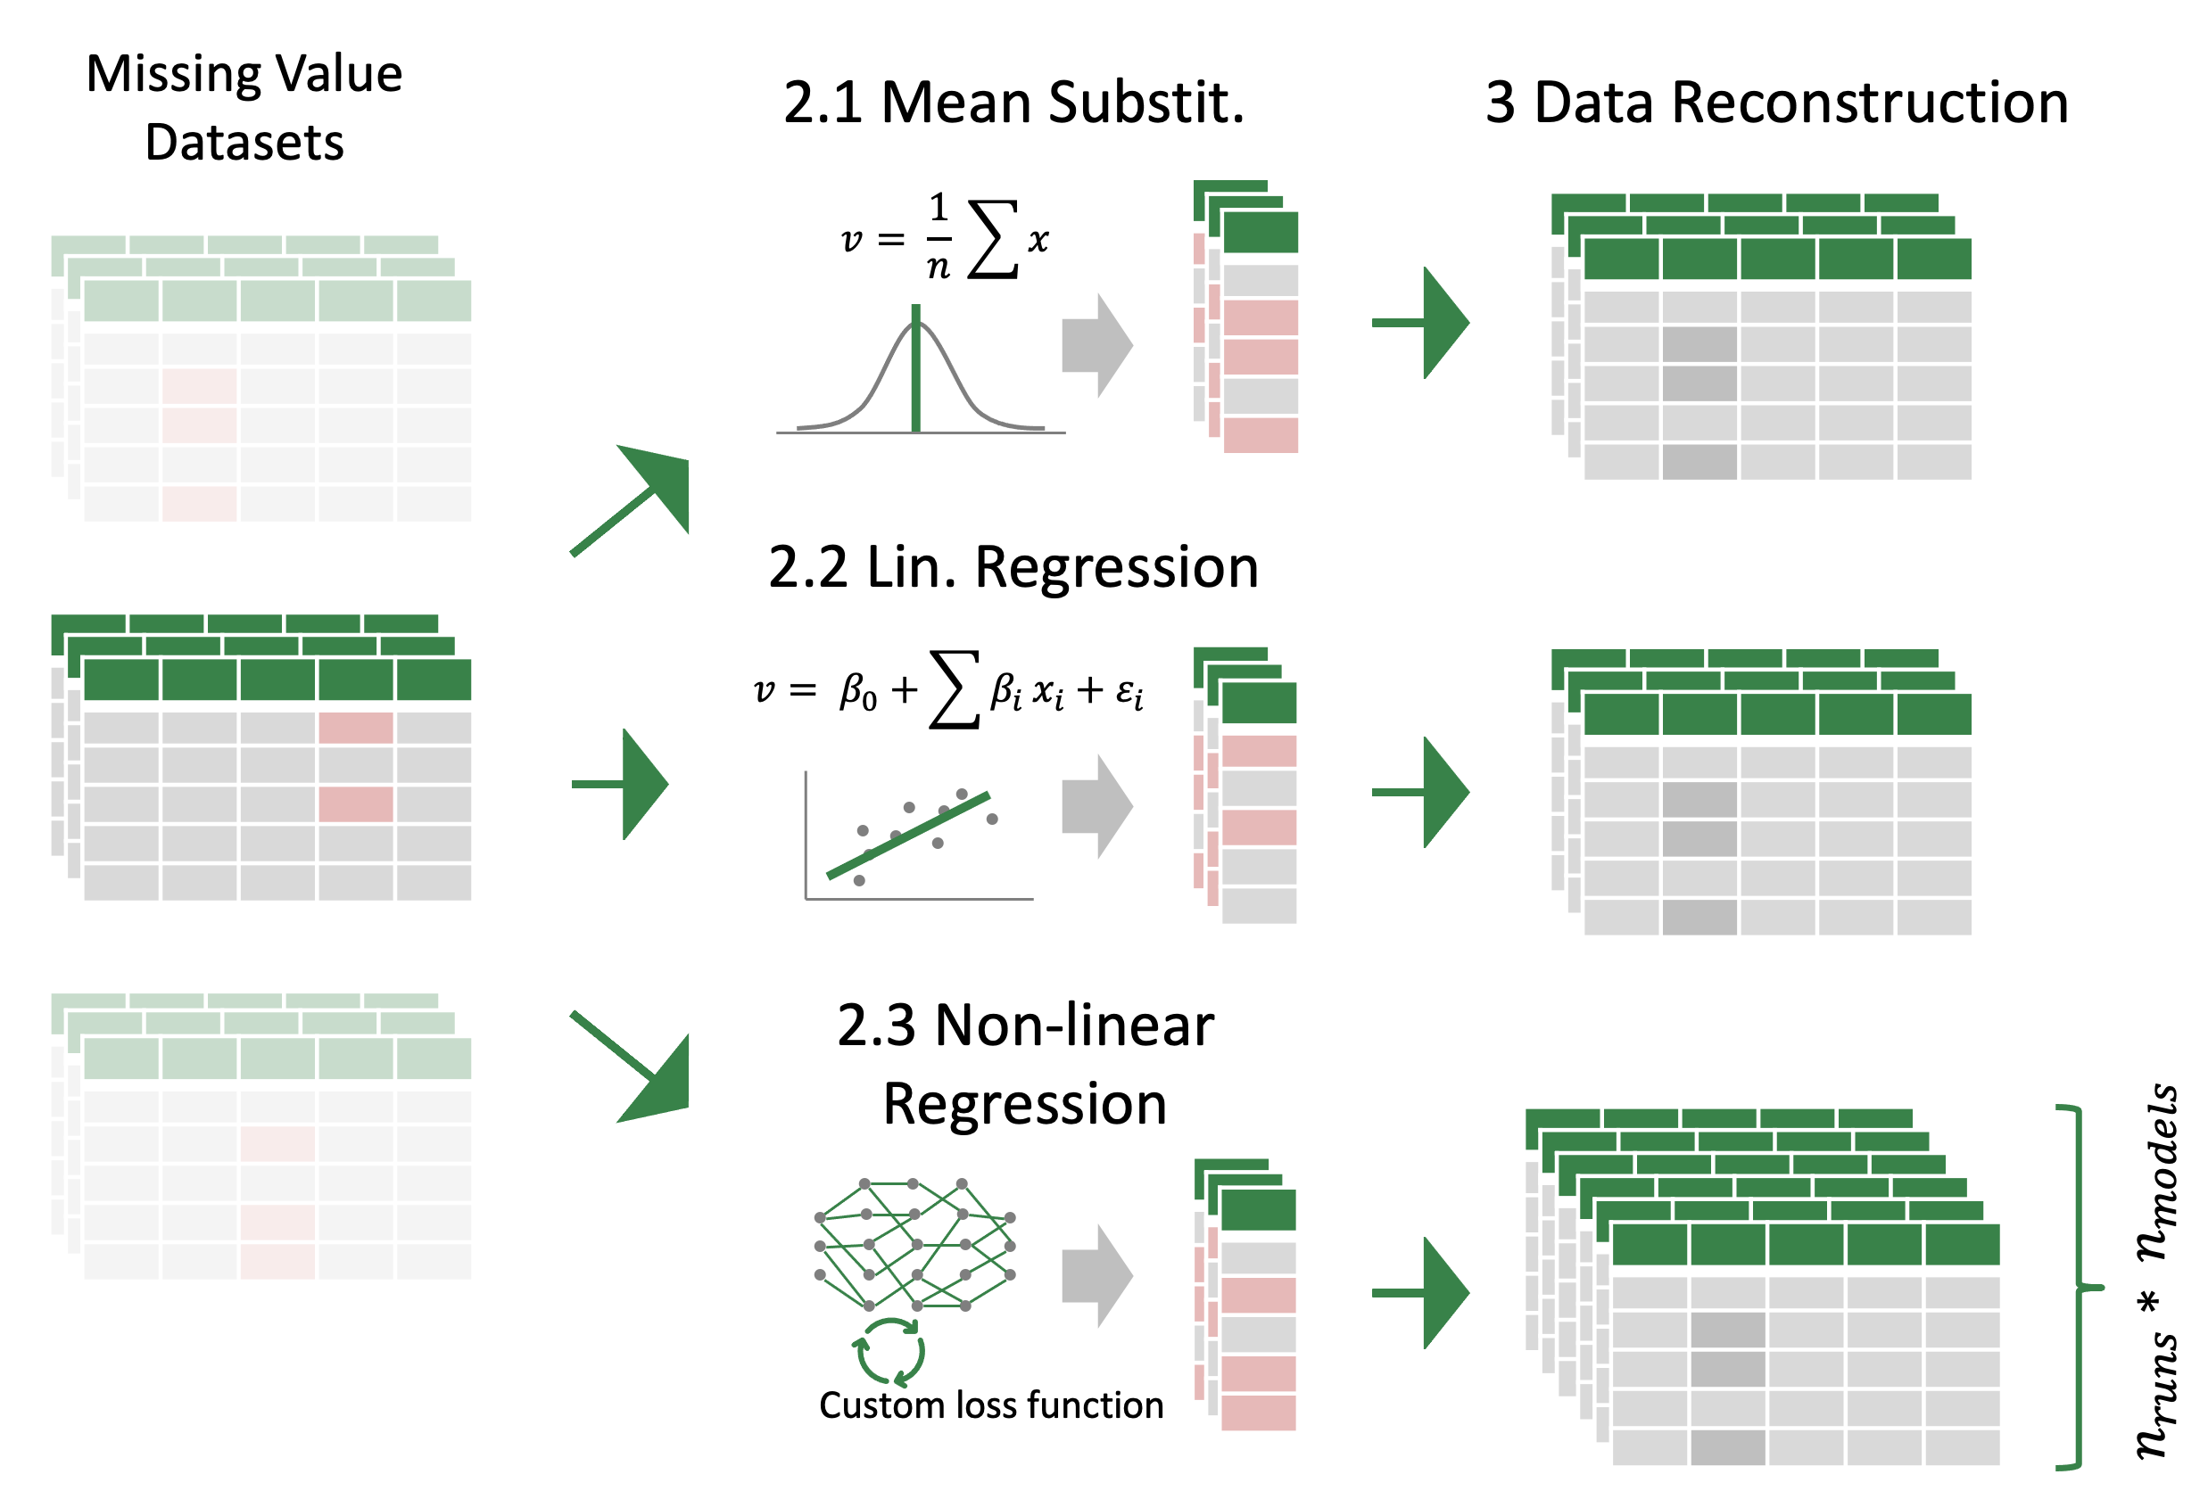
Concept
Model-based imputation with TabNet using different loss functions
Mean Absolute Error (MAE)
Root Mean Squared Error (RMSE)
Cluster-Mean-Loss (CML)
Distribution-Loss (DL)
Custom-Loss (CL)

Slide 16
Concept
Custom Loss Function
Weights
RMSE: Reconstruct original data.
Loss Objectives:
L_{REC} : Reconstruction Loss
L_{D} : Distribution Loss
L_{CM} : Cluster Mean Loss
Kullback–Leibler Divergence: Punish deviations from the original (probability) distribution.

Slide 17
Concept
Custom Loss Function
Weights
Distance to closest cluster mean: Encourage imputation values within
existing clusters.
Loss Objectives:
L_{REC} : Reconstruction Loss
L_{D} : Distribution Loss
L_{CM} : Cluster Mean Loss
x
d₁
d₂
x

Slide 18
Concept

Slide 19
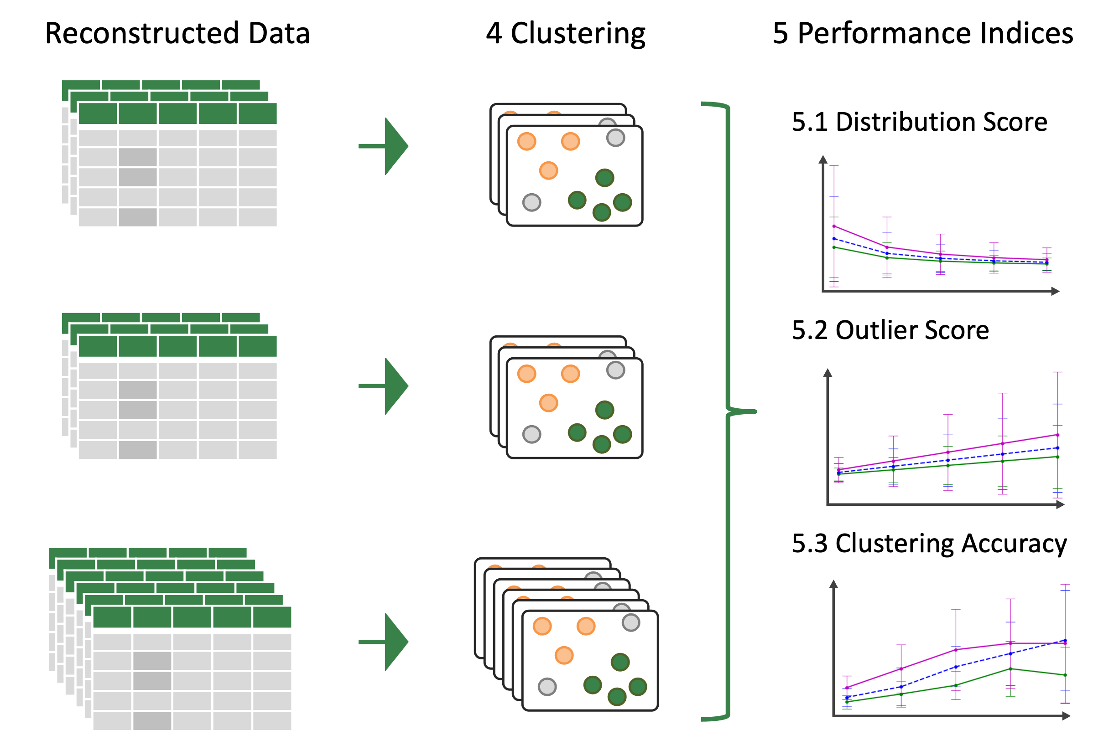
Concept

Slide 20
Contents
Introduction
Related Work
Research Questions
Concept
Evaluation
Experiments & Results
Conclusion & Future Work

Slide 21
Evaluation and Metrics
Distribution Preservance
KL Divergence
Measures, how well the imputation strategy is working for the preservation of the distribution.
Outlier Prediction Accuracy
True Positive Rate for Outlier Values (based on outlier definition)
Measures, how well the imputation strategy is working for the prediction of outliers.
Cluster Performance
Adjusted Rand Index (ARI)
Measures, how well the imputation strategy is working for the recreation of the original dataset clusters.
Notes:
ARI: 0 for random clustering (RI = expected RI for randomly chosen clusters), 1 if all points are in the correct clusters, < 0 if expected RI is larger than actual RI

Slide 22
Contents
Introduction
Related Work
Research Questions
Concept
Evaluation
Experiments & Results
Conclusion & Future Work

Slide 23
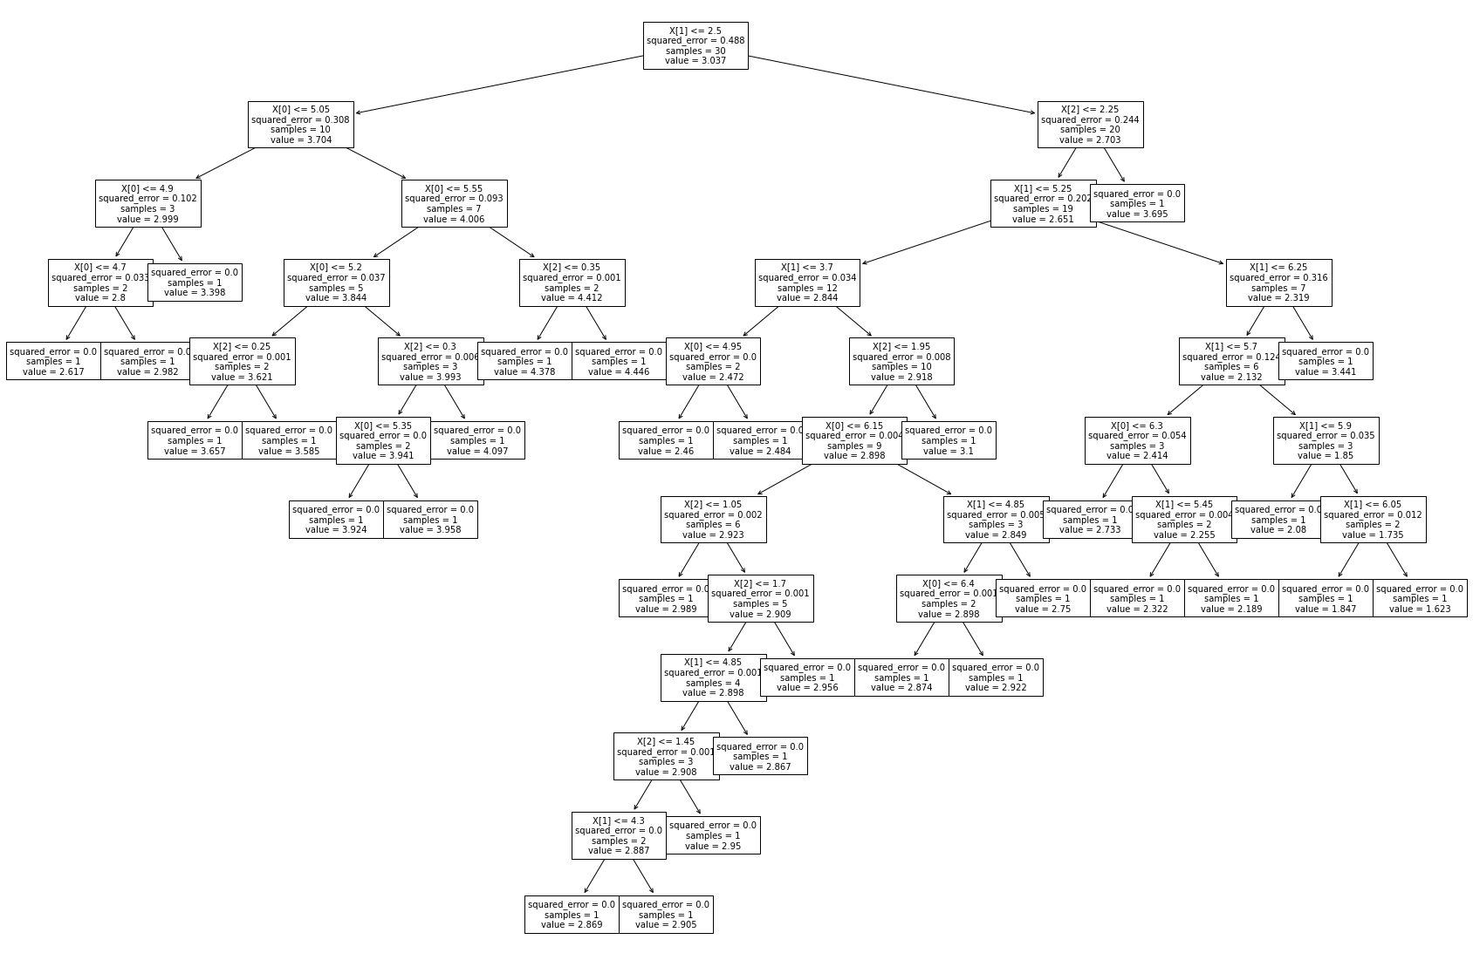
Experiments
Experiment Setups
Imputation Optimisation
Imputation Explainability
RQ1 & RQ2
Use default concept with varying
ratios of missing values (RQ1)
ratios of features containing missing values (RQ1)
ratios of features omitted (RQ2)
RQ3
Showcase of decision tree based on previously run experiment

Slide 24
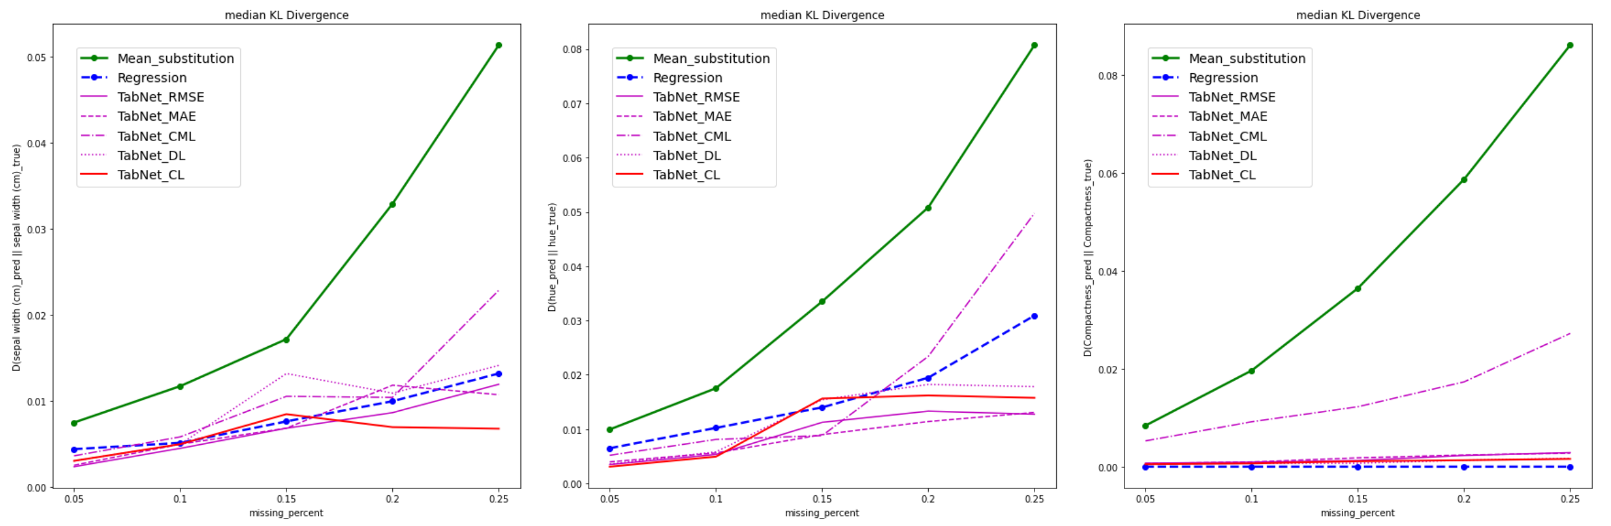
Results
KL Divergences (example or RQ1, varying ratio of MVs)
iris
dataset
wine
dataset
dry-beans
dataset

Slide 25
Results – Summary
Imputation Optimisation
RQ1 – MV ratios (5%, 10%, 15%, 20%, 25%)
 | iris | wine | dry beans
Distr. Pres. | + | + | +/-
Outlier TPR | ++ | ++ | +/-
Cluster. Perf. | - | +/- | +/-
Comments | Distribution & Outliers: Benefits for smaller datasets and higher MV ratios. Cluster Perf.: No significant advantage over other methods, esp. at higher MV ratios. General: CML suffers for large dry-bean dataset. General: No significant difference between loss functions (apart from CML).
Conclusion: Optimization is possible, but strong dependency on dataset

Slide 26
Results – Summary
Imputation Optimisation
RQ1 – MV_{features} ratios (10%, 20%, 30%, 40%, 50%)
 | iris | wine | dry beans
Distr. Pres. | ++ | ++ | +/-
Outlier TPR | ++ | ++ | +/-
Cluster. Perf. | +/- | - | -
Comments | Stable performance, independent of MV_{feature} ratio. CML suffers for large dry-bean dataset. No significant difference between loss functions (apart from CML).
Conclusion: Optimization of distr. pres. and outlier TPR possible, but mostly for small datasets. No optimisation of cluster performance.

Slide 27
Results – Summary
Imputation Optimisation
RQ2 – Missing feature ratios (10%, 30%, 50%, 70%, 90%)
 | iris | wine | dry beans
Distr. Pres. | - | + | +
Outlier TPR | + | + | +/-
Cluster. Perf. | - | +/- | +/-
Comments | TabNet performs best for large dataset with high missing feature ratios Negative impact of missing features for small datasets. Outlier performance can increase with missing features despite rising KL div. No significant difference between loss functions.
Conclusion: Optimization possible for small datasets and large datasets at high missing feature ratios.

Slide 28
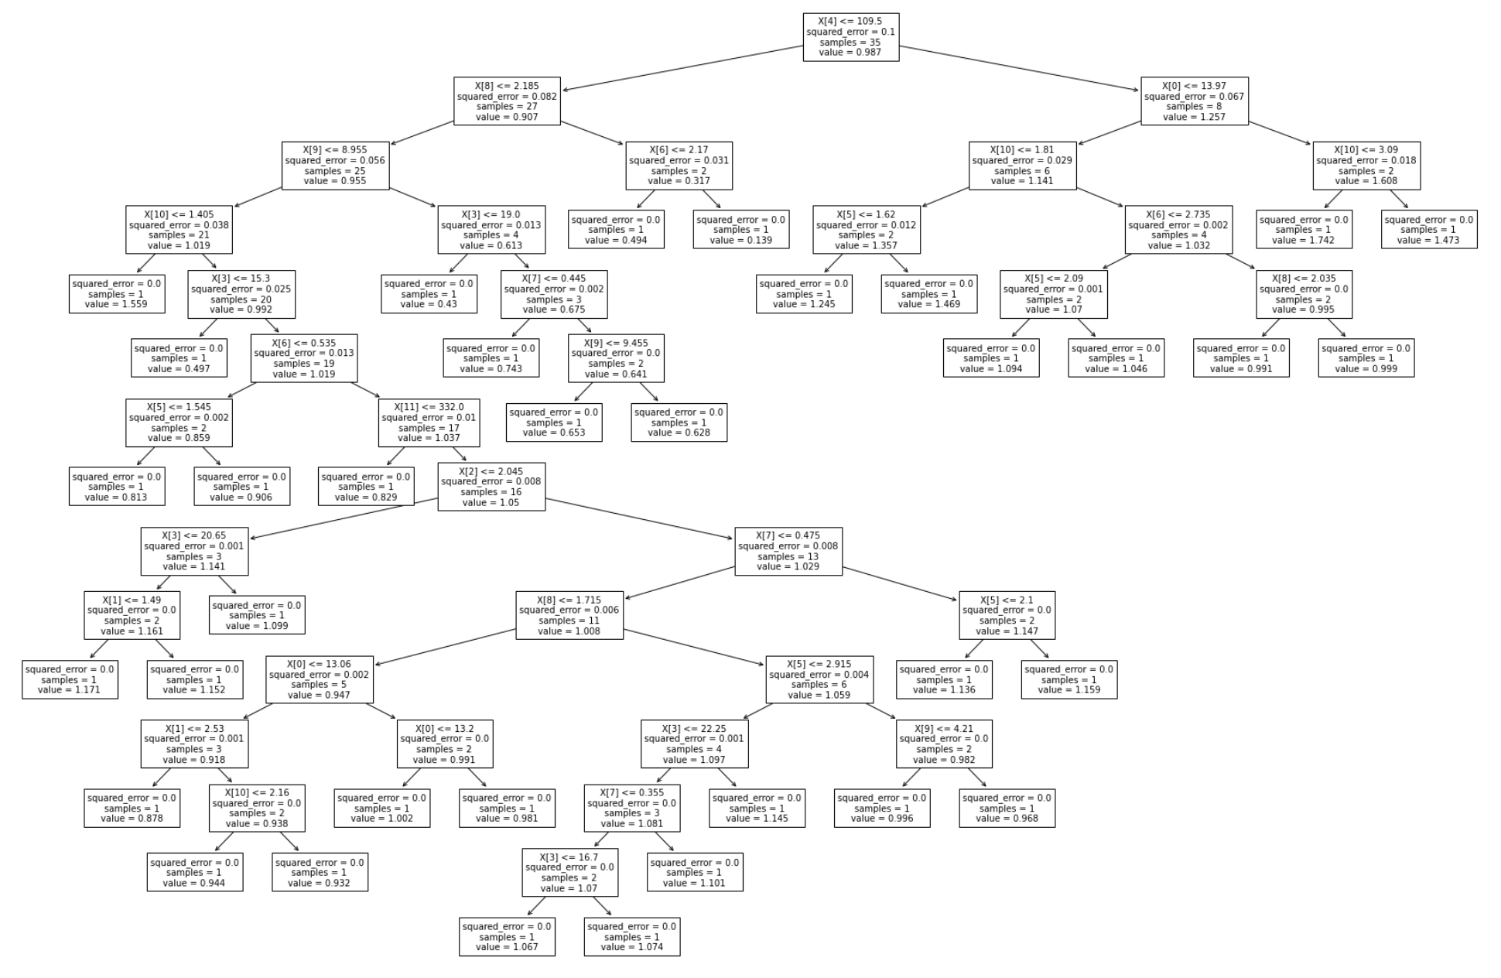
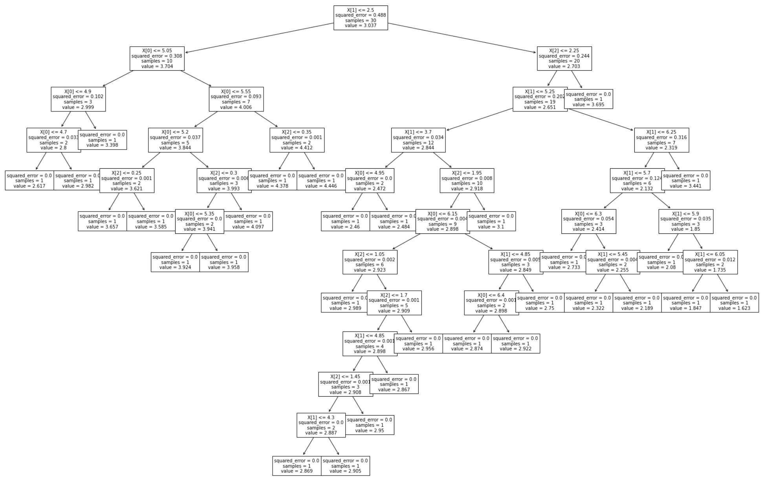
Results – Summary
Imputation Explainability
RQ3 – Decision trees on imputed values
iris
wine
Comment:
Growing tree depth with dataset size. Too large to print for large dry beans dataset.
Verification (e.g. by domain expert) needed.
Conclusion: Explainability could potentially be increased for small datasets (given a previous verification of the tree).

Slide 29
Contents
Introduction
Related Work
Research Questions
Concept
Evaluation
Experiments & Results
Conclusion & Future Work

Slide 30
Conclusion
RQ 1 How is it possible to improve clustering of missing values/dimensions datasets with model based filling strategies?
Improved distribution preservation and outlier accuracy for small datasets
no significant improvement over other methods in reconstructing the original clusters
+
-
RQ 2 How does the number of dimensions influence the cluster/outlier results?
Outperforms other methods for large, low-dimensional datasets
No general performance increase at high-dimensional dataset versions
Mixed results for smaller datasets
+
-
-
RQ 3 How is it possible to make model based filling strategies explainable?
Improved explainability for small datasets using decision trees
Requires verification
+
-

Slide 31
Future Work
Generalisation for other downstream tasks (anomaly detection, classification, …)
Use of TabNet feature importance to expand on dimensionality impact (RQ2) and explainability (RQ3)
Investigate wider range of imputation strategies
Replace KL divergence with a symmetric divergence score (such as Jeffrey Divergence^{[14]})

Slide 32
Sources
[1] | D. Rubin. Multiple imputation for nonresponse in surveys. Wiley Series in Probability and Statistics. Wiley, 1987.
[2] | Mustafa Alabadla et al. Systematic review of using machine learning in imputing missing values. In IEEE Access, volume 10, pages 44483–44502, 2022.
[3] | P. J. Garc ́ıa-Laencina et al. Pattern classification with missing data: a review. In Neural Computing and Applications, volume 19, page 263–282, 2010.
[4] | S. Ö. Arikand, T. Pfister. Tabnet: Attentive interpretable tabular learning (v5). In arXiv Computer Science, 2020.
[5] | C. C. Aggarwal et al. Fast algorithms for projected clustering. ACM SIGMOD Record, 22(2):61–72, 1999.
[6] | R. Agrawal et al. Automatic subspace clustering of high dimensional data for data mining applications. ACM SIGMOD Record, 27(2):94–105, 1998.
[7] | S. Goil et al. Mafia: Efficient and scalable subspace clustering for very large data sets. Technical Report No. CPDC-TR-9906-010, NWU, 1999.
[8] | J. Yoon et al. Vime: Extending the success of self- and semi-supervised learning to tabular domain. In Proceedings of the 34th International Con- ference on Neural Information Processing Systems, page 11033–11043, 2020.
[9] | R. Agarwal et al. Neural additive models: Interpretable machine learning with neural nets. In Advances in Neural Information Processing Systems, volume 34, pages 4699–4711. Curran Associates, Inc., 2021.
[10] | M. C. P. de Souto et al. Impact of missing data imputation methods on gene expression clustering and classification. BMC Bioinformatics, 16(64), 2015.
[11] | J. Tuikkala et al. Missing value imputation improves clustering and interpretation of gene expression microarray data. BMC Bioinformatics, 9(202), 2008.
[12] | D. Wang et al. Effects of replacing the unreliable cdna microarray measurements on the disease classification based on gene expression profiles and functional modules. Bioinformatics, 22(23):2883–2889, 2006.
[13] | M. Celton et al. Comparative analysis of missing value imputation meth- ods to improve clustering and interpretation of microarray experiments. BMC Bioinformatics, 11(15), 2010.
[14] | M. Deza and E. Deza. Encyclopedia of Distances. Springer Dordrecht Heidelberg London New York, 2009.

